Slide 1
KR using Rules

Slide 2
KR using Rules
A set of rules to represent both knowledge about relationships in the world
as well as knowledge about how to solve the problem using the content of the rules.

Slide 3
Procedural versus Declarative Knowledge
A procedural representation is one in which the control information that is necessary to use the knowledge is embedded in the knowledge itself.
for e.g. computer programs, directions, and recipes; these indicate specific use or implementation.
The real difference between declarative and procedural views of knowledge lies in where control information reside.
Procedural Knowledge also known as Interpretive knowledge, is the type of knowledge in which it clarifies how a particular thing can be accomplished. It is not so popular because it is generally not used.
It emphasize how to do something to solve a given problem.

Slide 4
Procedural versus Declarative Knowledge
If only one value needed, then the answer to the question will depend on the order in which the assertions examined during the search for a response.
If the assertions declarative then they do not themselves say anything about how they will be examined.
In case of procedural representation, they say how they will examine.

Slide 5
Declarative Knowledge
Declarative Knowledge also known as Descriptive knowledge, is the type of knowledge which tells the basic knowledge about something and it is more popular than Procedural Knowledge.
It emphasize what to do something to solve a given problem
A statement in which knowledge specified, but the use to which that knowledge is to be put is not given. So to use declarative representation, we must have a program that explains what is to do with the knowledge and how.
For example, laws, people’s name; these are the facts which can stand alone, not dependent on other knowledge;
For example, a set of logical assertions can combine with a resolution theorem prover to give a complete program for solving problems but in some cases, the logical assertions can view as a program rather than data to a program.
Hence the implication statements define the legitimate reasoning paths and automatic assertions provide the starting points of those paths.
These paths define the execution paths which is similar to the ‘if then else “in traditional programming.
So we can view logical assertions as a procedural representation of knowledge.

Slide 6
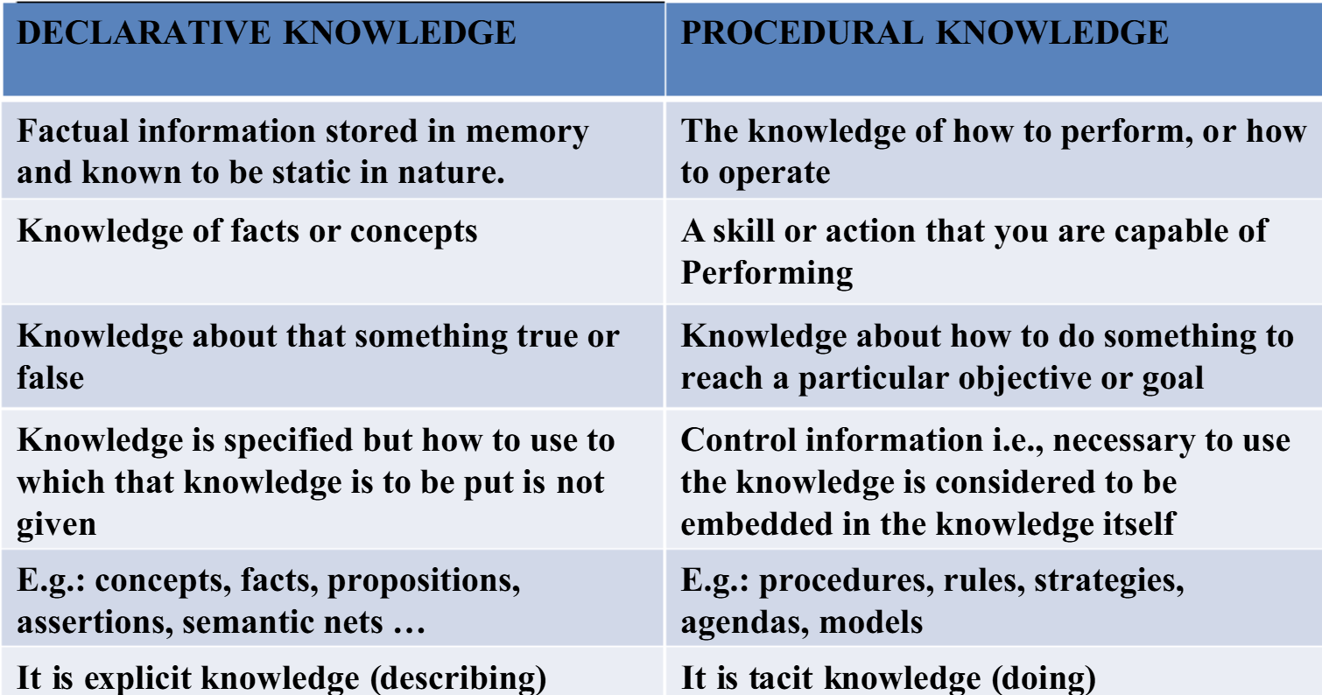

Slide 7
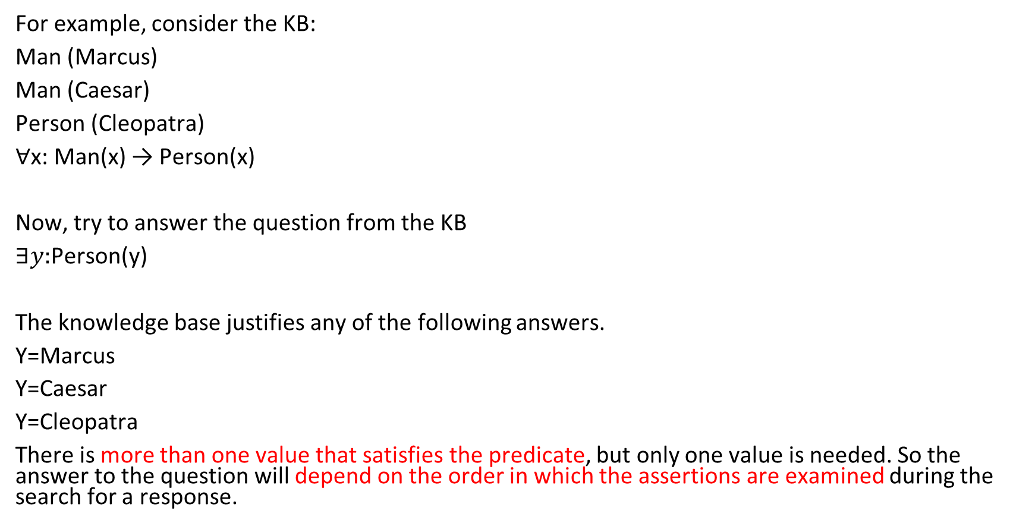
Procedural versus Declarative Knowledge

Slide 8
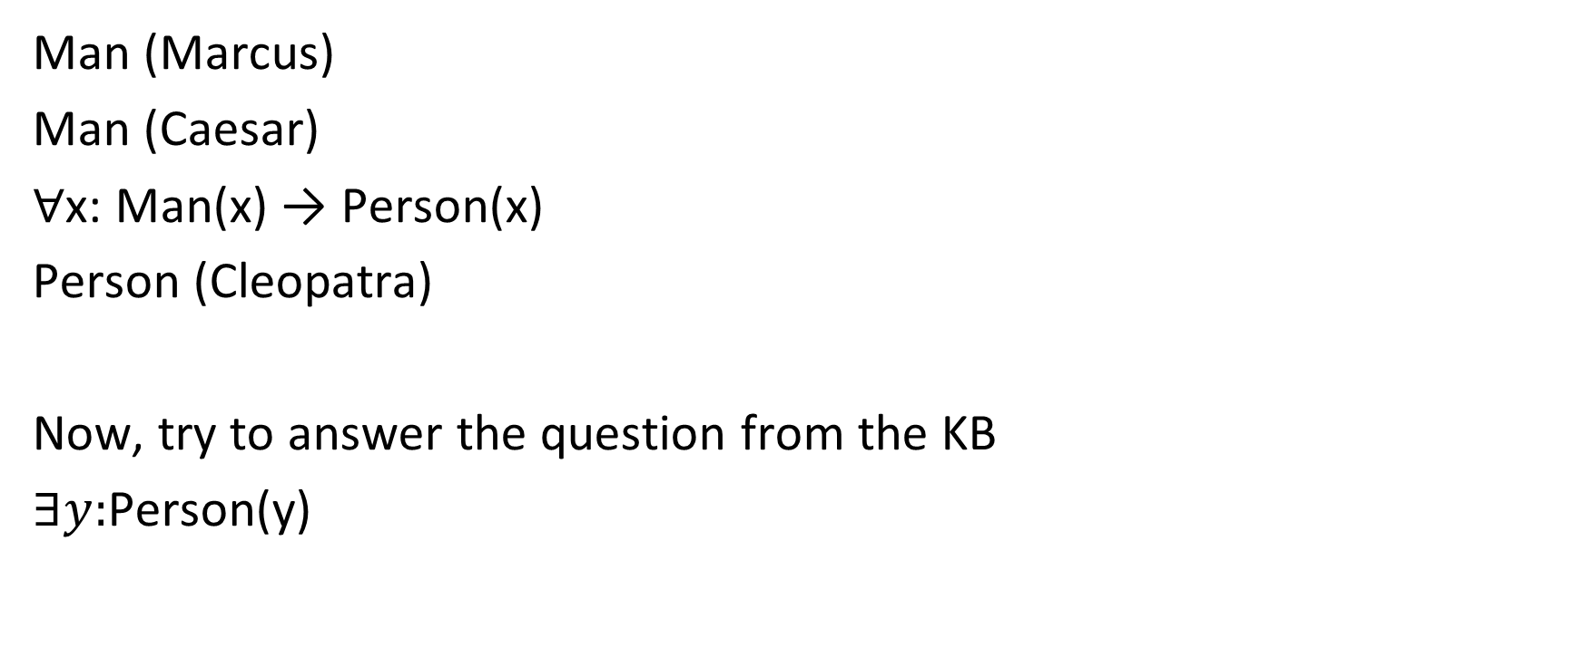

Slide 9
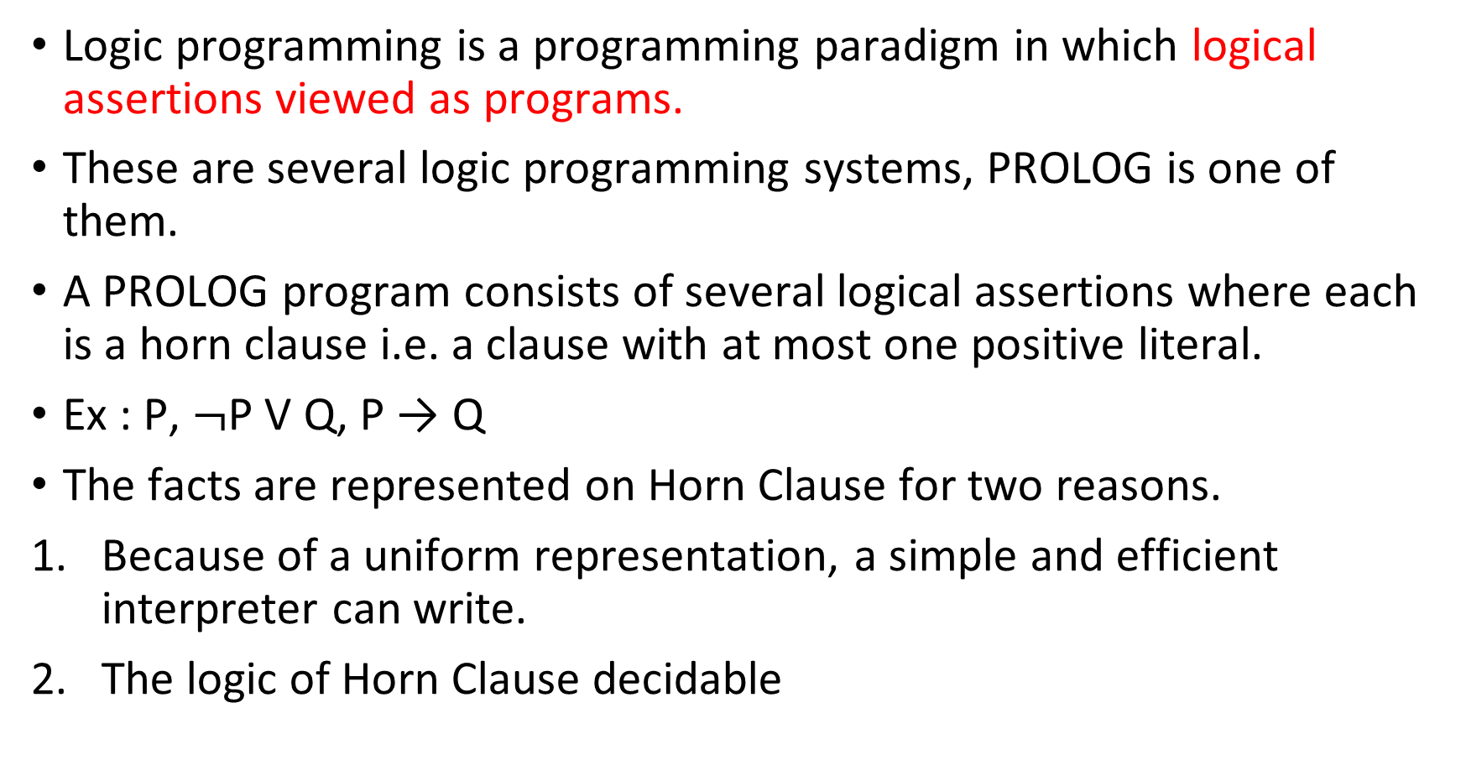
Logic Programming

Slide 10
The first two differences are the fact that PROLOG programs are actually sets of Horn clause that have been transformed as follows:-
1. If the Horn Clause contains no negative literal (i.e contains a single positive literal), then leave it as it is.
2. Otherwise rewrite the Horn clauses as an implication, combining all of the negative literals into the antecedent of the implications and the single positive literal into the consequent.
Moreover, This procedure causes a clause which originally consisted of a disjunction of literals (one of them was positive) to be transformed into a single implication whose antecedent is a conjunction universally quantified.
But when we apply this transformation, any variables that occurred in negative literals and so now occur in the antecedent become existentially quantified, while the variables in the consequent are still universally quantified.
For example the PROLOG clause
P(x): – Q(x, y) is equal to logical expression ∀x: ∃y: Q (x, y) → P(x).
The difference between the logic and PROLOG representation is that the PROLOG interpretation has a fixed control strategy. And so, the assertions in the PROLOG program define a particular search path to answer any question.
But, the logical assertions define only the set of answers but not about how to choose among those answers if there is more than one.

Slide 11
Horn Clauses
A Horn clause is a special kind of clause in propositional logic or predicate logic that has at most one positive literal.
It is widely used in logic programming (Prolog) and automated reasoning because it can be efficiently resolved.
Fact (a positive literal only)
  Example:
    rain. (It is raining.)
    Predicate logic: Rain(x)
Rule (implication form)
  Example:
    Predicate logic: Rain → Wet
    wet :- rain. (The ground is wet if it rains.)
    General form: A ← B1∧B2∧...∧Bn
    Meaning: A is true if all B’s are true.
Goal / Query (only negative literals, no positive literal)
  Example:
    ?- wet. (Is the ground wet?)

Slide 12
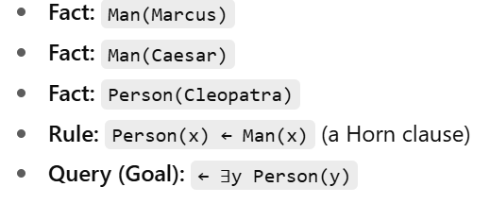
Examples of Horn Clauses in Prolog
Fact: human(socrates).
Rule: mortal(X) :- human(X).
(X is mortal if X is human.)
Query:
?- mortal(socrates).

Slide 13
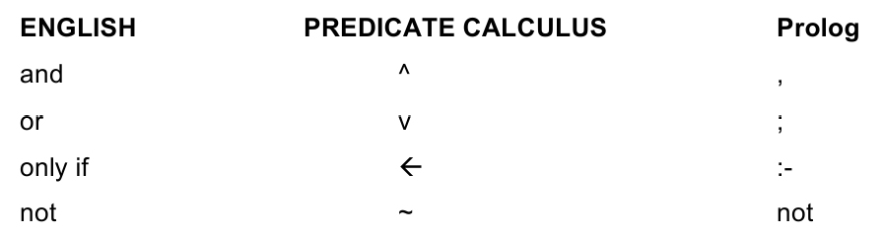
Rules for representation

Slide 14
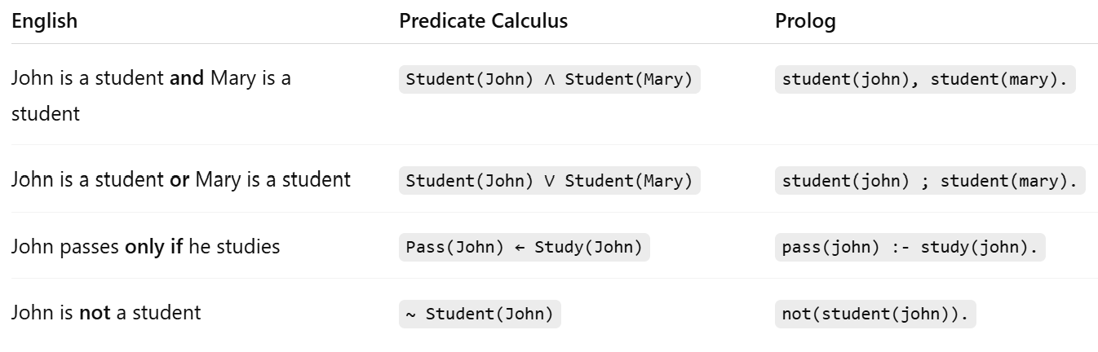

Examples

Slide 15
Prolog representation
Facts
FOL
All small pet are apartment pets.
All cat and dog are pets.
Poodle is a small dog.
Fluffy is poodle.
apartmentpet (x) :- pet(x), small (x)
pet (x):- cat (x).
pet (x):- dog(x).
dog(x):- poodle (x).
small (x):- poodle(x).
poodle (fluffy)
∀x : pet(x) ۸ small (x) → apartmentpet(x)
∀x : cat(x) ۸ dog(x) → pet(x)
∀x : poodle (x) → dog (x) ۸ small (x)
poodle (fluffy)

Slide 16
Find a value of X that satisfies the predicate apartmentpet(X).
PROLOG as ?-apartmentpet(X)
PROLOG Program
apartmentpet (x) :- pet(x), small (x).
pet (x):- cat (x).
pet (x):- dog(x).
dog(x):- poodle (x).
small (x):- poodle(x).
poodle (fluffy).
The program halts with the result apartmentpet(fluffy)

Slide 17
Example
Knowledge base:
cat(x) ∧ fish(y) ⇒ likesToEat(x,y)
∀x calico(x) ⇒ cat(x)
∀x tuna(x) ⇒ fish(x)
tuna(Charlie)
tuna(Herb)
calico(Puss)
PROLOG
likesToEat(x,y) :- cat(x) , fish(y).
cat(x) :- calico(x).
fish(x) :- tuna(x).
tuna(Charlie).
tuna(Herb).
calico(Puss).
Query
?-likesToEat(Puss,x)
Answer: charlie

Slide 18
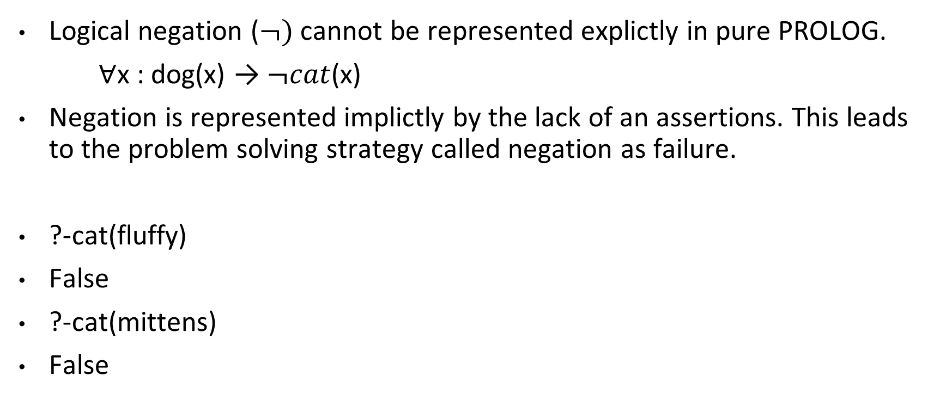

Slide 19
Example
a) Horn Clause
¬cat(x) v ¬ fish(y) ⇒ likestoeat(x,y)
¬ calico(x) ⇒ cat(x)
¬ tuna(x) ⇒ fish(x)
tuna(Charlie)
tuna(Herb)
calico(Puss)
b) PROLOG Program
likestoeat(x,y):- cat(x) ; fish(y).
cat(x) :- calico(x).
fish(x) :- tuna(x).
tuna(Charlie).
tuna(Herb).
calico(Puss).
c) Query
?-likestoeat(Puss,x)
Answer: charlie

Slide 20
EXAMPLE
likes(dan, sally)
likes(sally,dan)
likes(josh, brittney)
Friendship(X,Y):-likes (X,Y); likes(Y,X)
?-likes(dan,sally) TRUE
?-friendship(dan,sally) TRUE
?- friendship(josh, sally) FALSE
?- friendship(josh, brittney) TRUE

Slide 21
Forward versus Backward Reasoning
A search procedure must find a path between initial and goal states.
There are two directions in which a search process could proceed.
The two types of search are:
Forward search which starts from the start state
Forward rules which encode knowledge about how to respond to certain input configurations.
2. Backward search that starts from the goal state
Backward rules, which encode knowledge about how to achieve particular goal.
The production system views the forward and backward as symmetric processes.

Slide 22
Matching
Indexing
Matching with Variables
Complex and Approximate Matching
Conflict Resolution
Control Knowledge

Slide 23
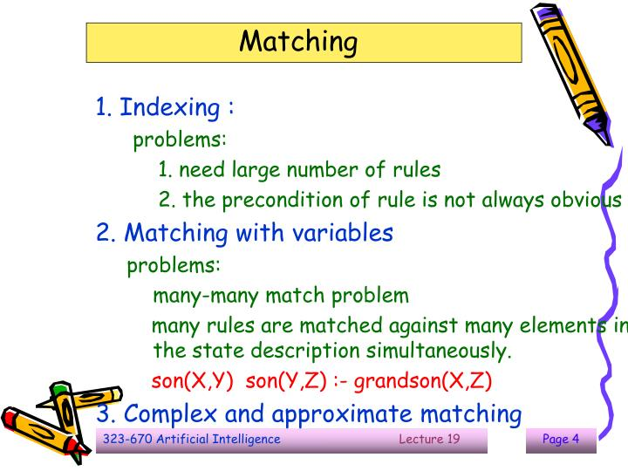

Slide 24
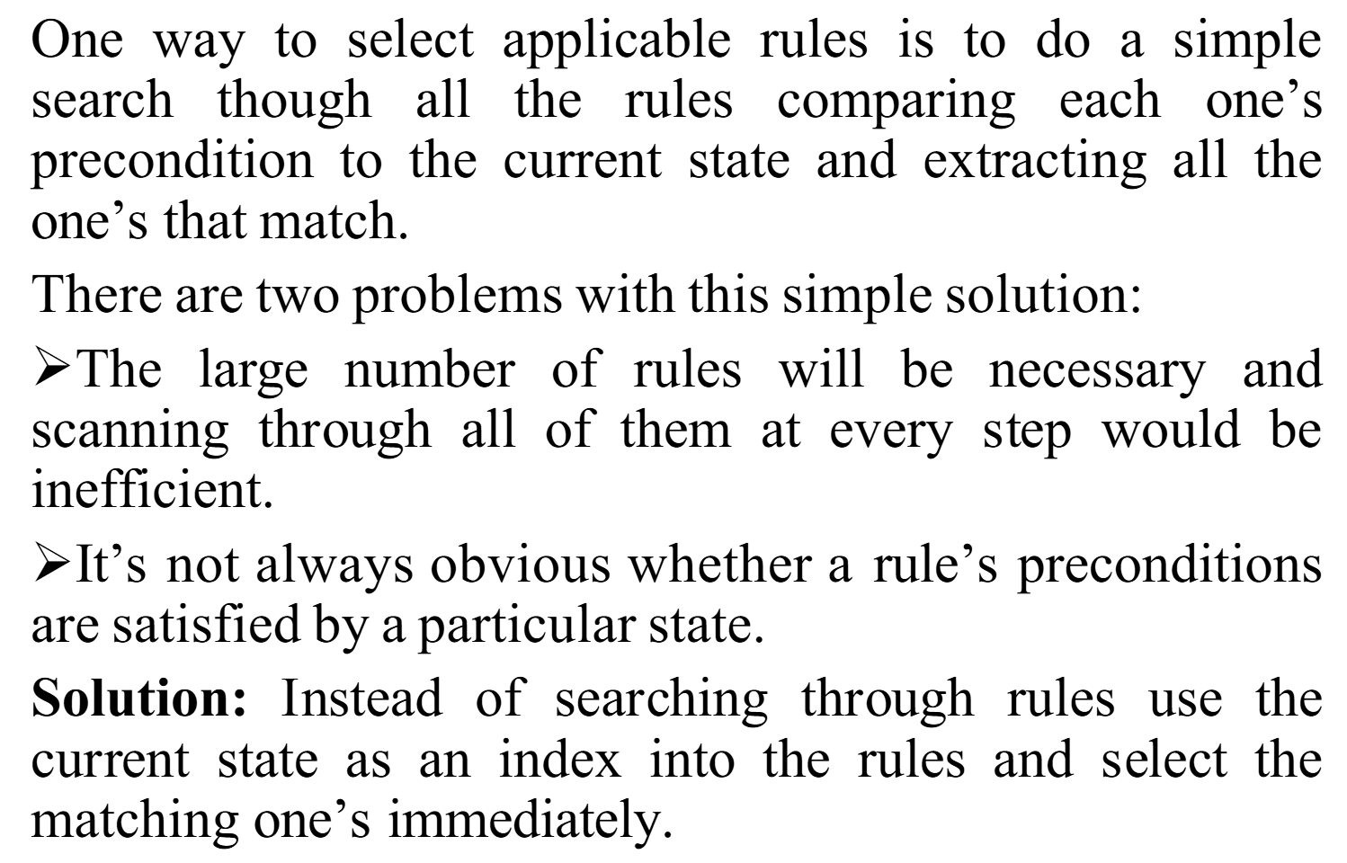
Indexing

Slide 25
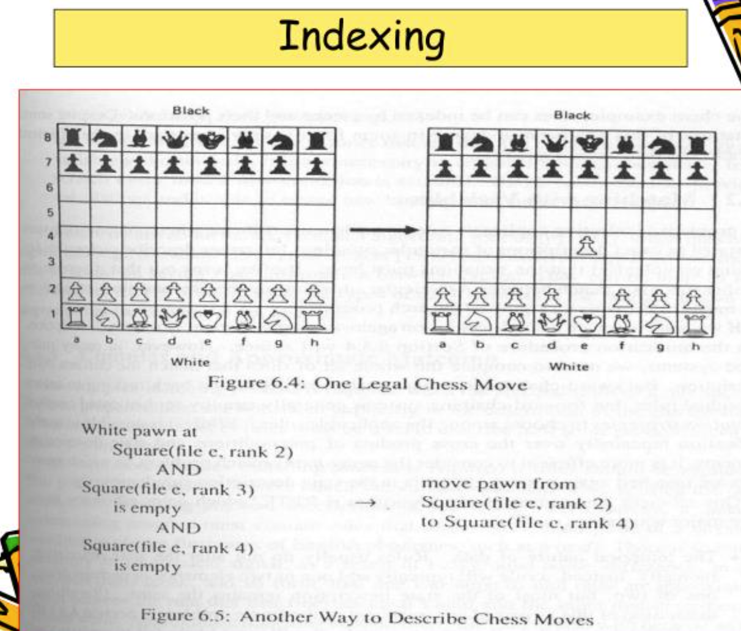
Indexing

Slide 26
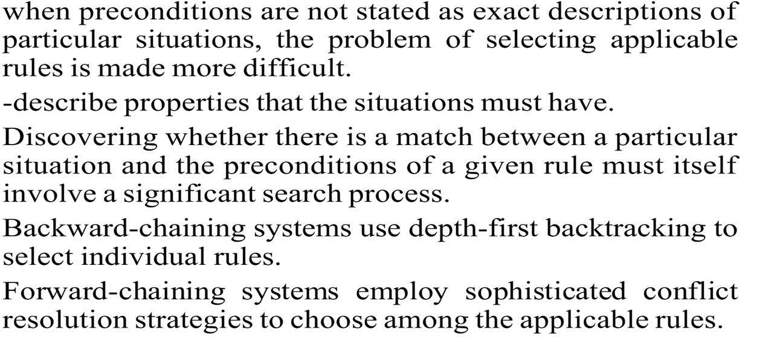
Matching with variables

Slide 27
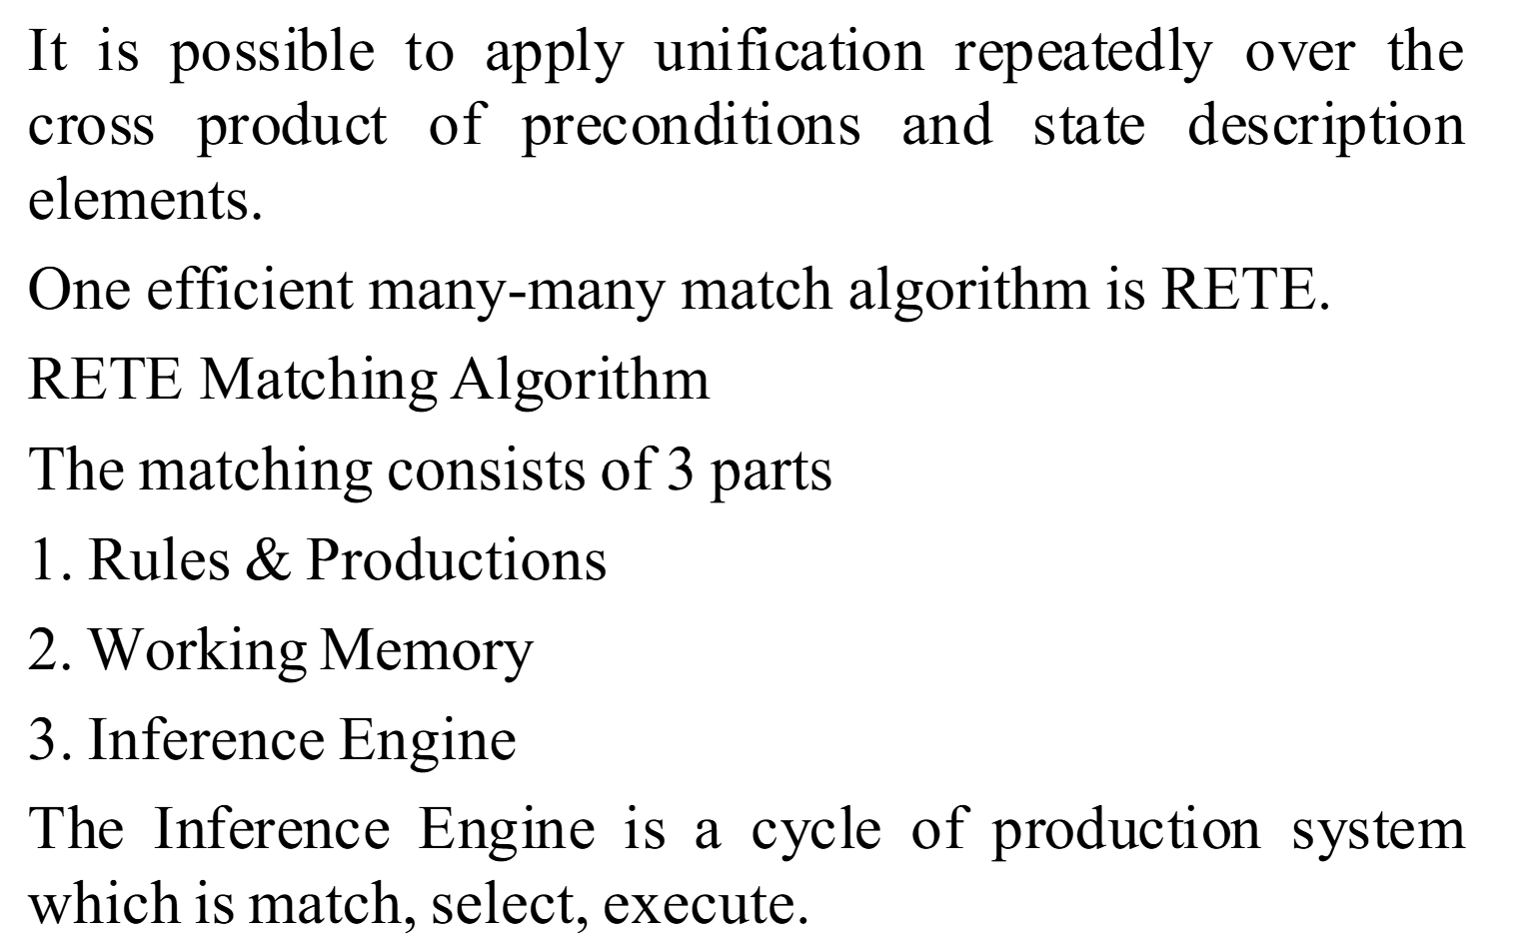
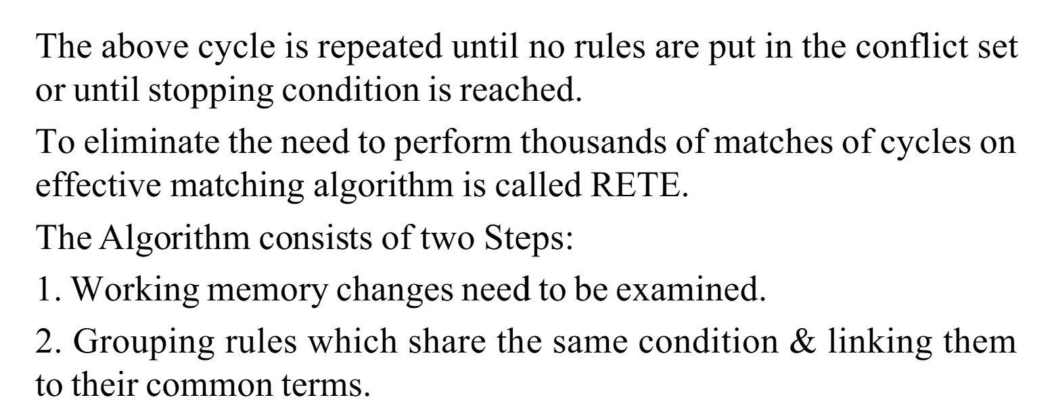
The Rete algorithm is a pattern matching algorithm for implementing rule-based systems. The algorithm was developed to efficiently apply many rules or patterns to many objects, or facts, in a knowledge base. It is used to determine which of the system's rules should fire based on its data store, its facts.

Slide 28
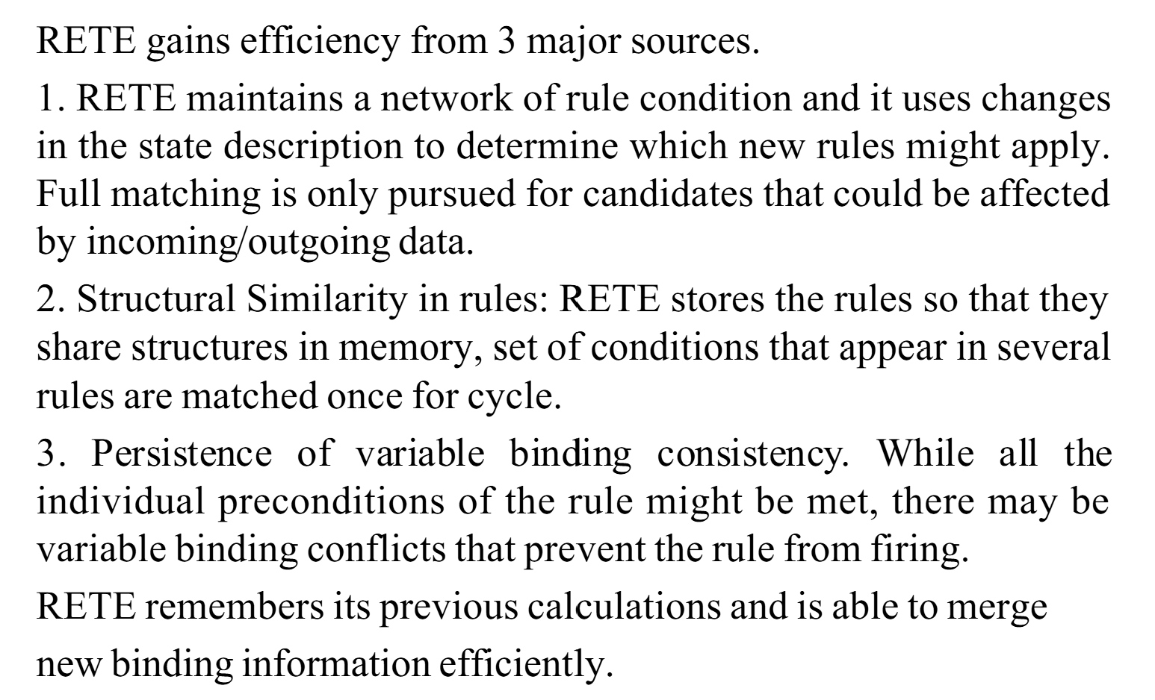
RETE – 3 major sources
Temporal nature of data
Structural Similarity in rules
Persistence of variables binding consistency
Rule 1 concludes Jaguar(x) if mammal(x), feline(x), carnivorous(x) and hasspots(X)
Rule 2 concludes tiger(x) replace hasspots with hasstripes

Slide 29
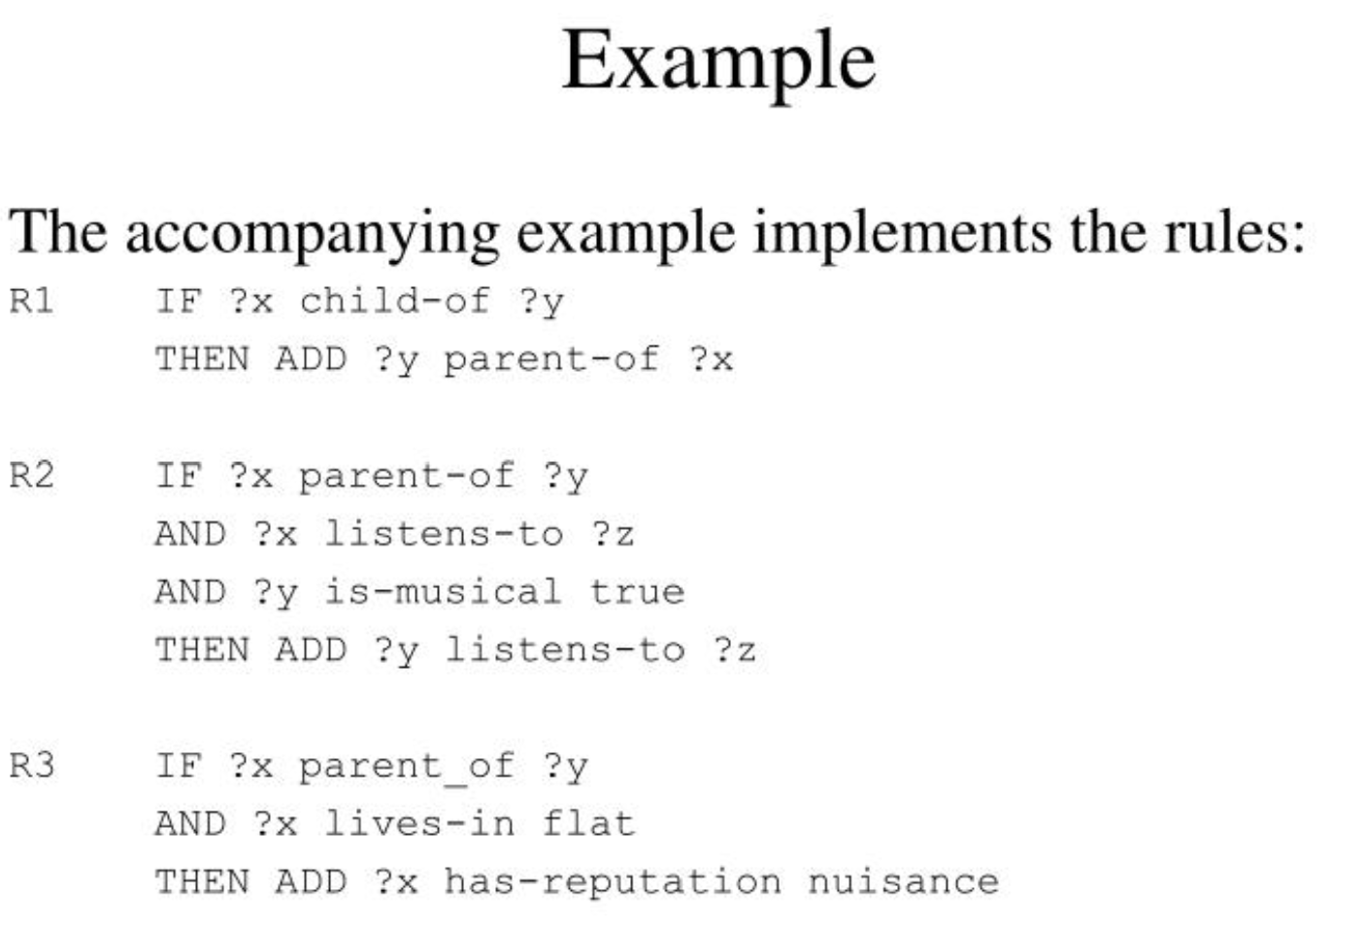
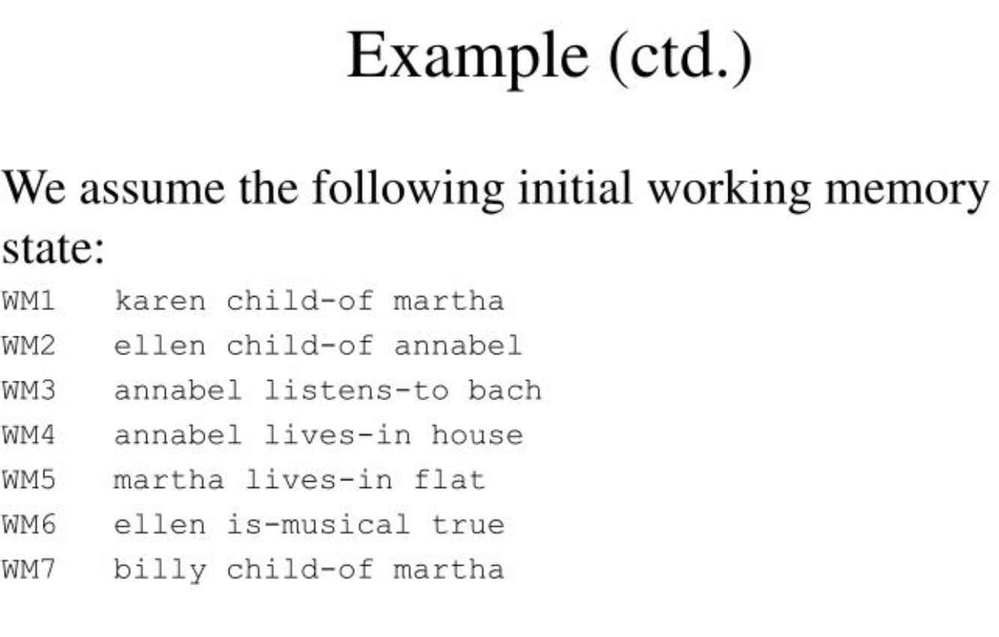
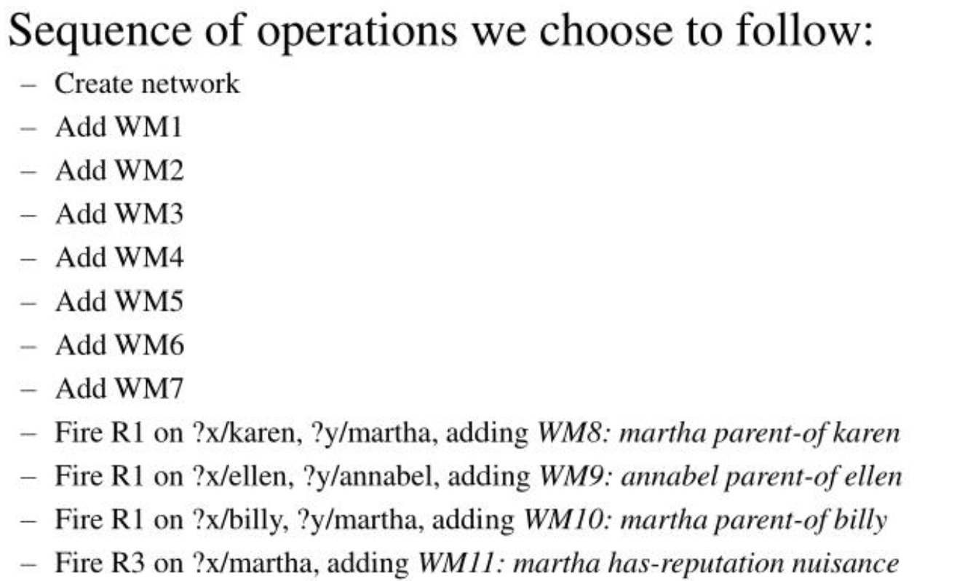

Slide 30
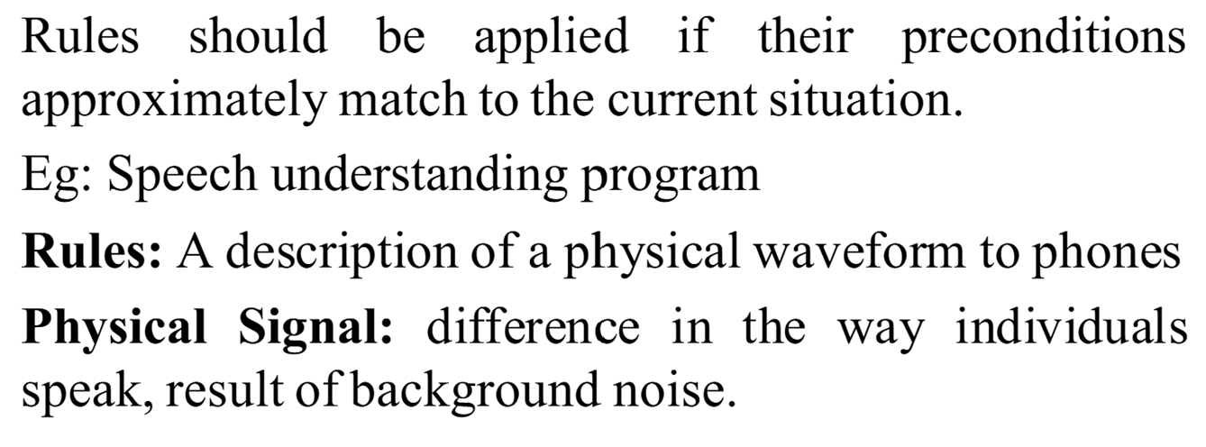
Complex and Approximate Matching

Slide 31
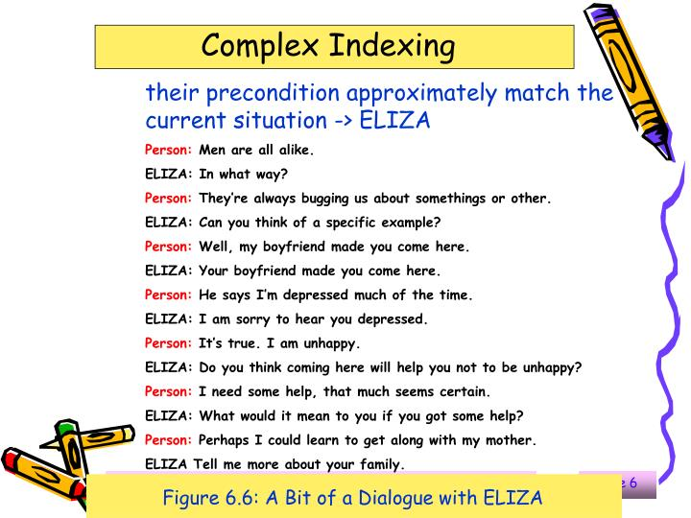

Slide 32
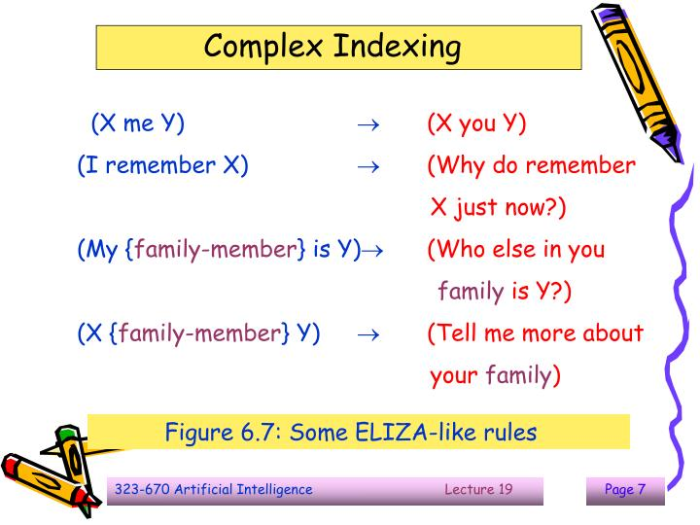

Slide 33
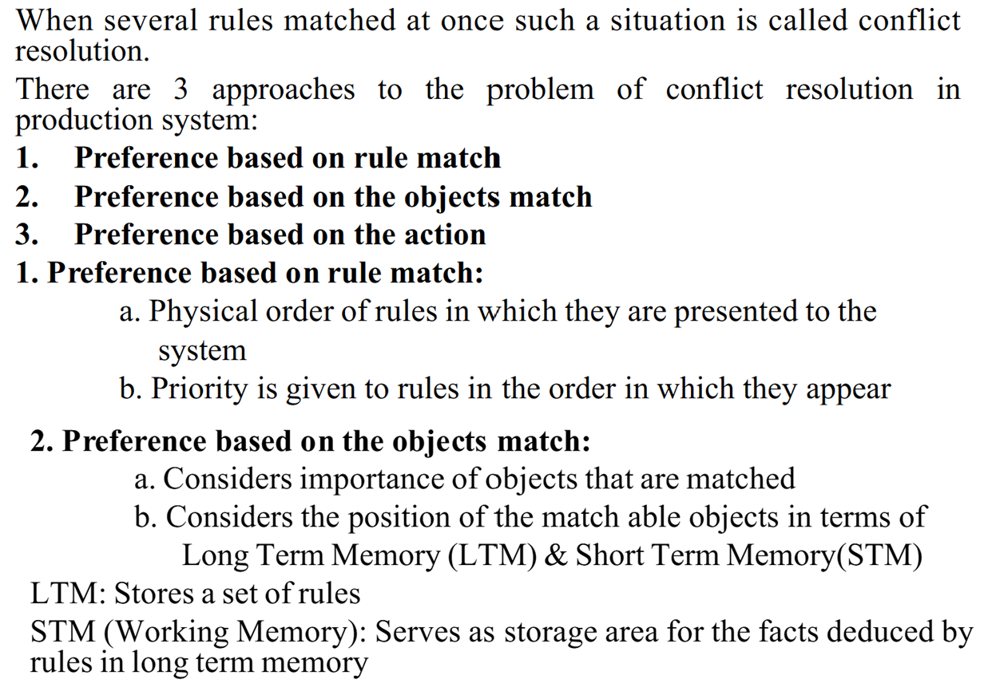
Conflict Resolution

Slide 34
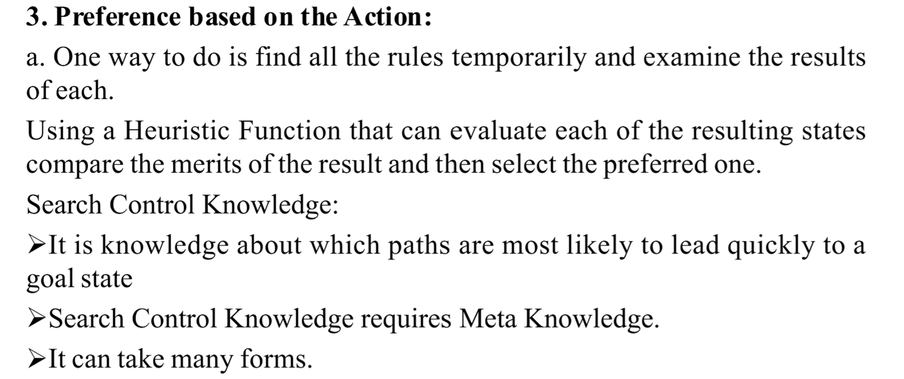

Slide 35
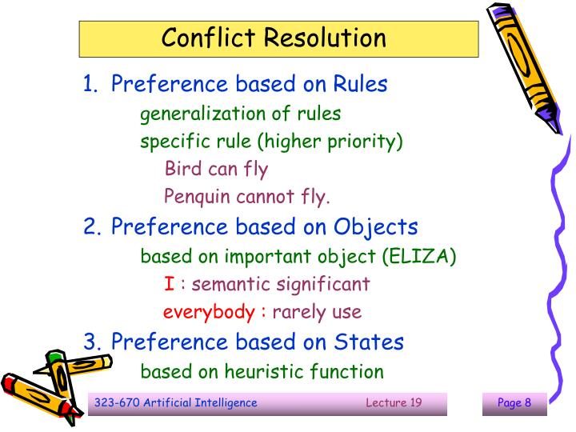

Slide 36
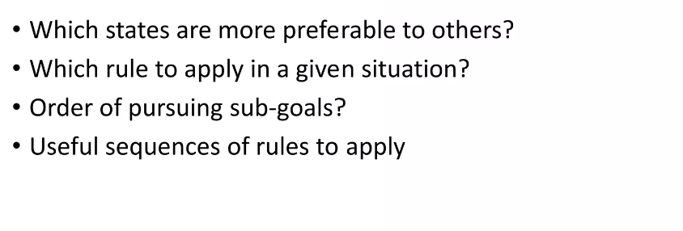
Control Knowledge
Knowledge about which paths are most likely to lead quickly to a goal state is often called search control knowledge. It can take many forms: Knowledge about

Slide 37
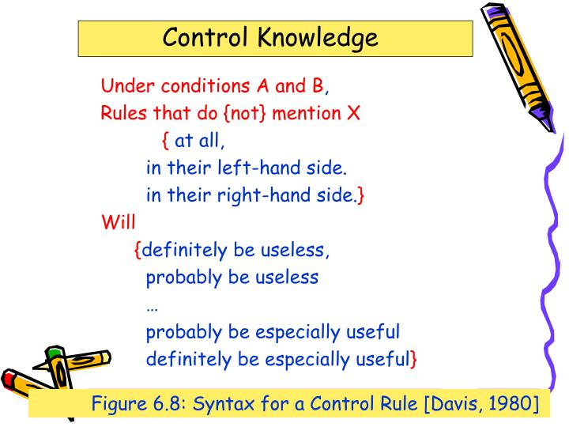

Slide 38
